Slide 1
High-Dimensional Continuous Control Using Generalized Advantage Estimation
Presented by Jialun Lyu and Zhibo Zhang
Original Paper: Schulman, John & Moritz, Philipp & Levine, Sergey & Jordan, Michael & Abbeel, Pieter. (2015).
High-Dimensional Continuous Control Using Generalized Advantage Estimation.

Slide 2
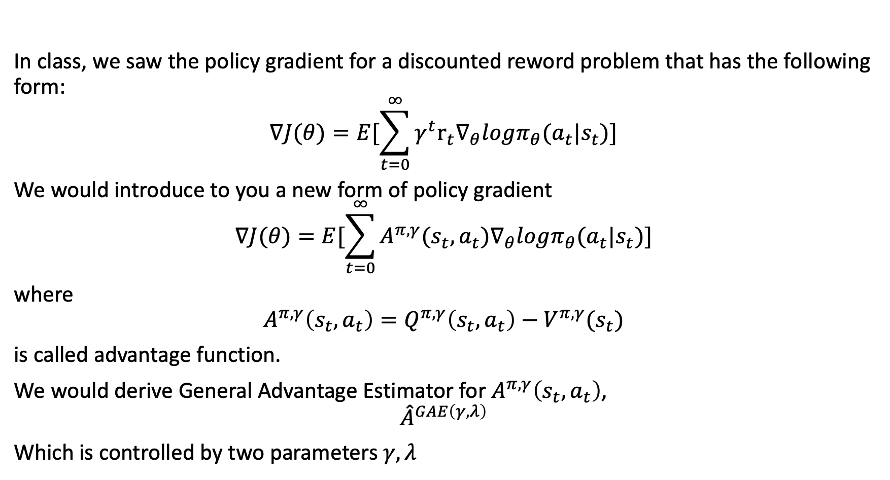
Motivation
In class, we saw the policy gradient for a discounted reword problem that has the following form:
$$∇J(θ)=E[\sum_{t=0}^{∞}{{γ^{t}r}_{t}∇_{θ}logπ_{θ}(a_{t}|s_{t})}]$$
We would introduce to you a new form of policy gradient
$$∇J(θ)=E[\sum_{t=0}^{∞}{A^{π,γ}(s_{t},a_{t})∇_{θ}logπ_{θ}(a_{t}|s_{t})}]$$
where
$$A^{π,γ}\left(s_{t},a_{t}\right)=Q^{π,γ}\left(s_{t},a_{t}\right)−V^{π,γ}(s_{t})$$
is called advantage function.
We would derive General Advantage Estimator for $A^{π,γ}\left(s_{t},a_{t}\right)$,
$${\hat{A}}^{GAE\left(γ,λ\right)}$$
Which is controlled by two parameters $γ,λ$

Slide 3
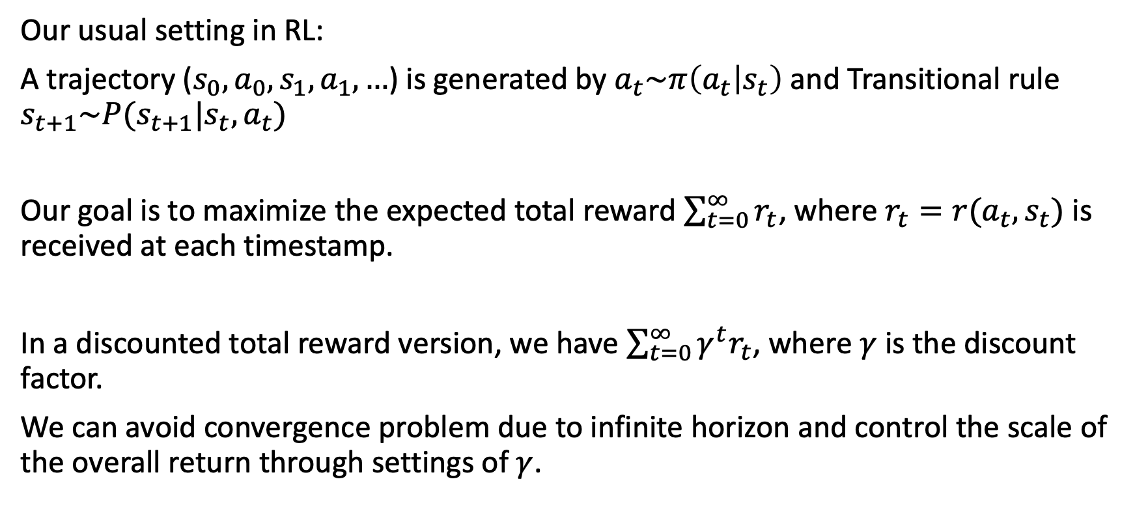
Problem Setting
Our usual setting in RL:
A trajectory ($s_{0}, a_{0}, s_{1}, a_{1}, …$) is generated by $a_{t}\sim π\left(a_{t} | s_{t}\right)$ and Transitional rule $s_{t+1}\sim P(s_{t+1}|s_{t},a_{t})$
Our goal is to maximize the expected total reward $\sum_{t=0}^{∞}{r_{t}}$, where $r_{t}=r(a_{t},s_{t})$ is received at each timestamp.
In a discounted total reward version, we have $\sum_{t=0}^{∞}{γ^{t}r_{t}}$, where $γ$ is the discount factor.
We can avoid convergence problem due to infinite horizon and control the scale of the overall return through settings of $γ$.

Slide 4
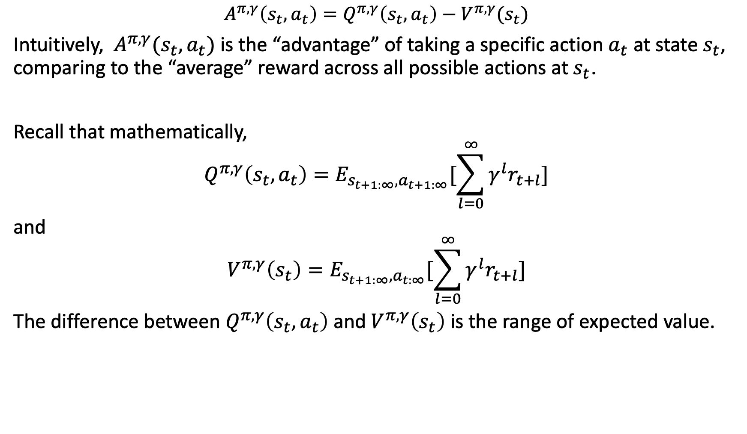
Advantage Function
$$A^{π,γ}\left(s_{t},a_{t}\right)=Q^{π,γ}\left(s_{t},a_{t}\right)−V^{π,γ}(s_{t})$$
Intuitively, $A^{π,γ}(s_{t},a_{t})$ is the “advantage” of taking a specific action $a_{t}$ at state $s_{t}$, comparing to the “average” reward across all possible actions at $s_{t}$.
Recall that mathematically,
$$Q^{π,γ}\left(s_{t},a_{t}\right)=E_{s_{t+1:∞}, a_{t+1:∞}}[\sum_{l=0}^{∞}{{γ^{l}r}_{t+l}}]$$
and
$$V^{π,γ}\left(s_{t}\right)=E_{s_{t+1:∞}, a_{t:∞}}[\sum_{l=0}^{∞}{γ^{l}r_{t+l}}]$$
The difference between $Q^{π,γ}\left(s_{t},a_{t}\right)$ and $V^{π,γ}\left(s_{t}\right)$ is the range of expected value.

Slide 5
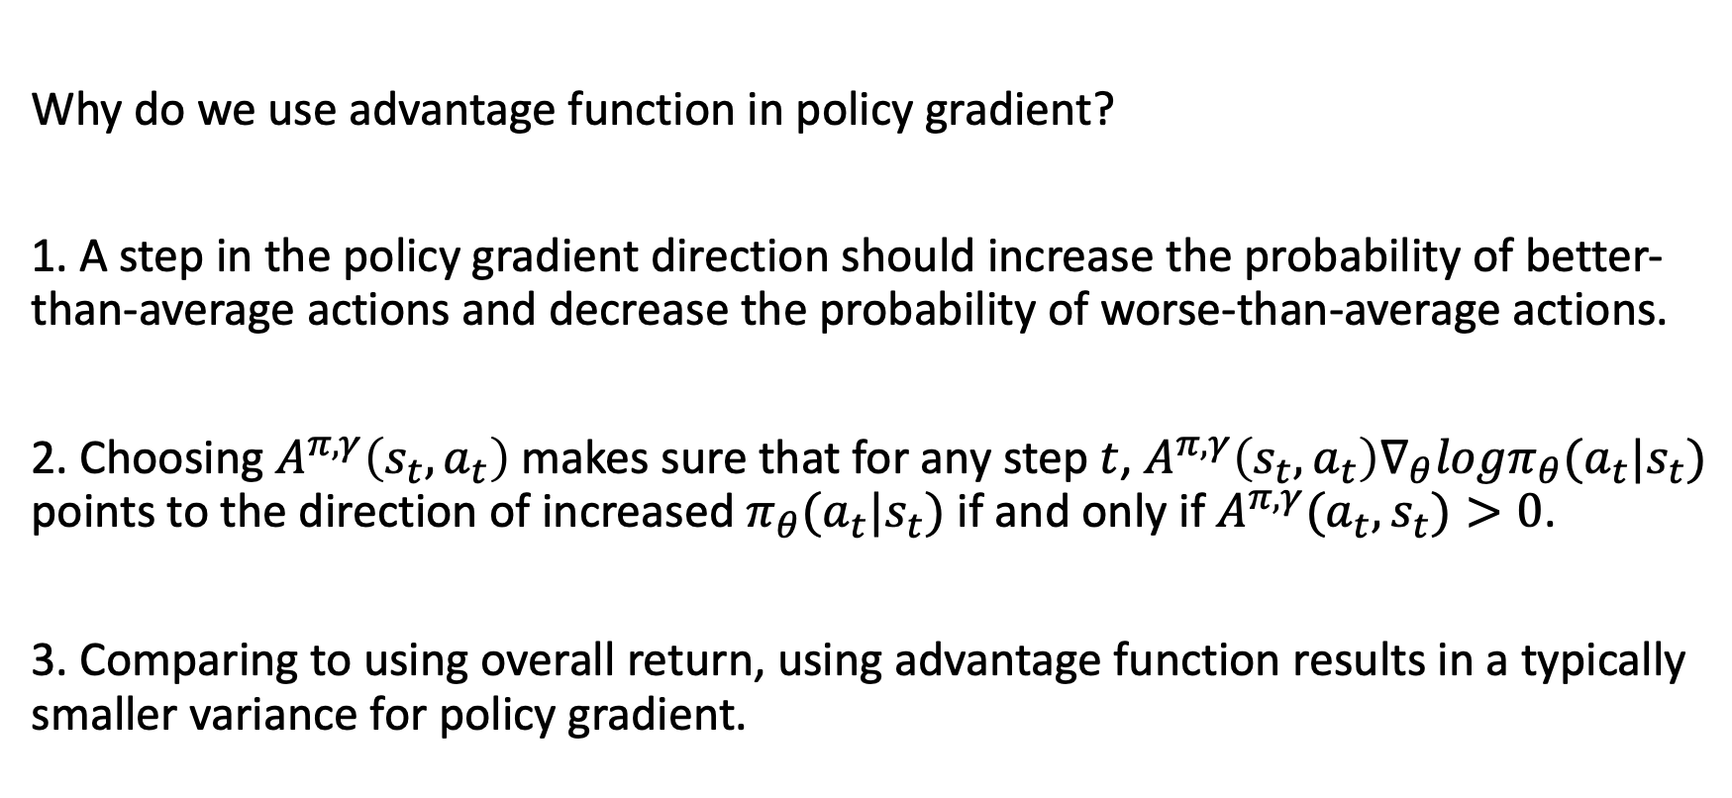
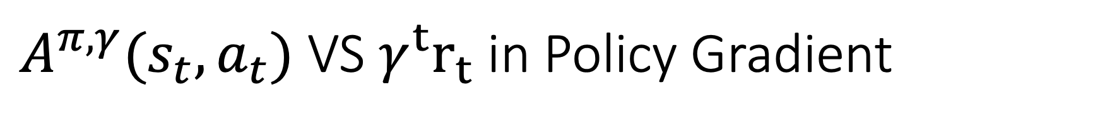
$A^{π,γ}(s_{t},a_{t})$ VS $γ^{t}r_{t}$ in Policy Gradient
Why do we use advantage function in policy gradient?
1. A step in the policy gradient direction should increase the probability of better-than-average actions and decrease the probability of worse-than-average actions.
2. Choosing $A^{π,γ}\left(s_{t},a_{t}\right)$ makes sure that for any step $t$, $A^{π,γ}\left(s_{t},a_{t}\right)∇_{θ}logπ_{θ}(a_{t}|s_{t})$ points to the direction of increased $π_{θ}(a_{t}|s_{t})$ if and only if $A^{π,γ}(a_{t},s_{t})>0$.
3. Comparing to using overall return, using advantage function results in a typically smaller variance for policy gradient.

Slide 6
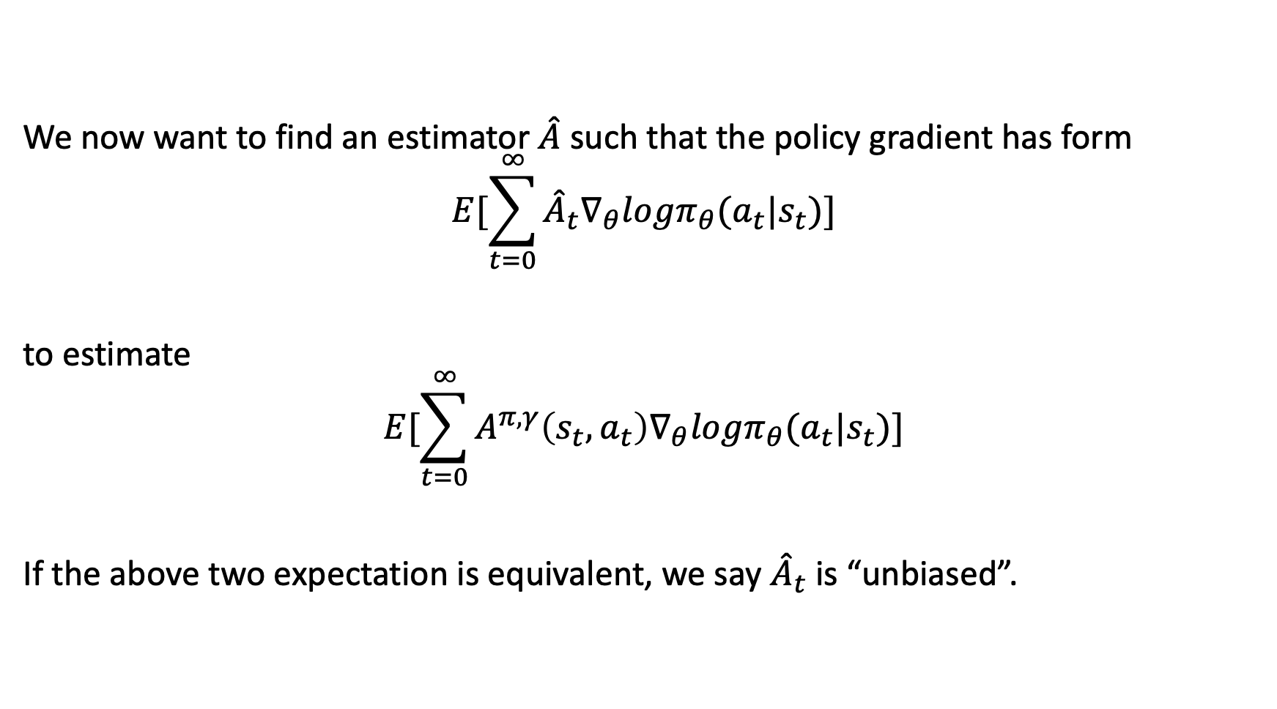
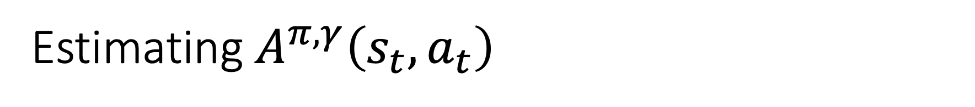
Estimating $A^{π,γ}\left(s_{t},a_{t}\right)$
We now want to find an estimator $\hat{A}$ such that the policy gradient has form
$$E[\sum_{t=0}^{∞}{{\hat{A}}_{t}∇_{θ}logπ_{θ}(a_{t}|s_{t})}]$$
to estimate
$$E[\sum_{t=0}^{∞}{A^{π,γ}\left(s_{t},a_{t}\right)∇_{θ}logπ_{θ}(a_{t}|s_{t})}]$$
If the above two expectation is equivalent, we say ${\hat{A}}_{t}$ is “unbiased”.

Slide 7
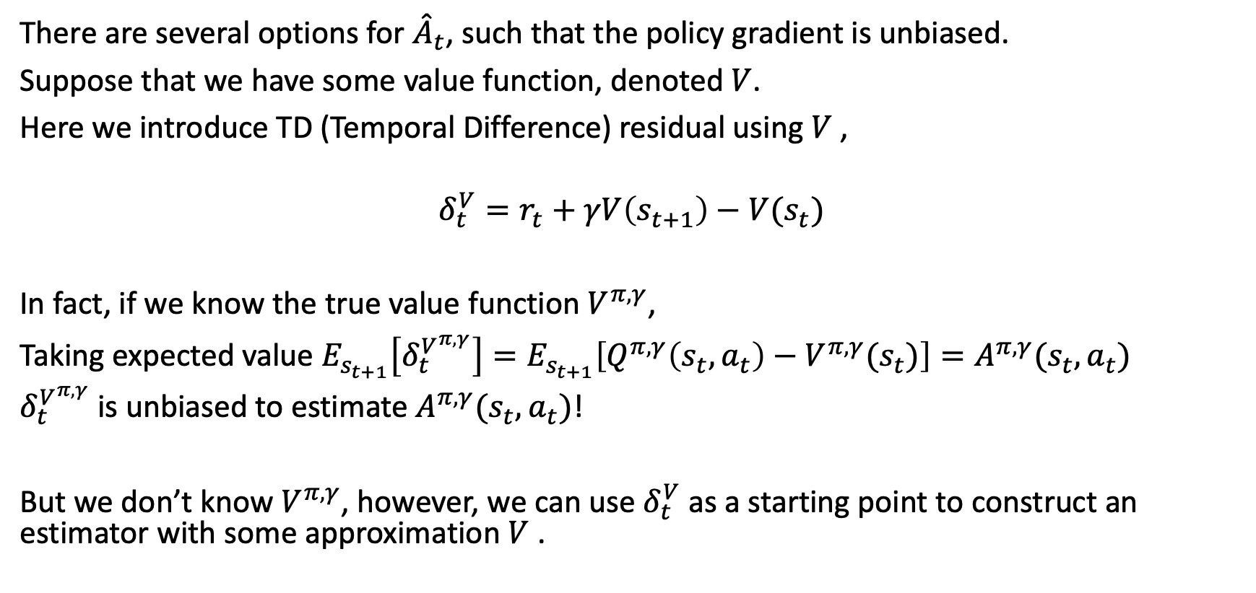

Finding ${\hat{A}}_{t}$
There are several options for ${\hat{A}}_{t}$, such that the policy gradient is unbiased.
Suppose that we have some value function, denoted $V$.
Here we introduce TD (Temporal Difference) residual using $V$ ,
$$δ_{t}^{V}=r_{t}+γV\left(s_{t+1}\right)−V(s_{t})$$
In fact, if we know the true value function $V^{π,γ}$,
Taking expected value $E_{s_{t+1}}\left[δ_{t}^{V^{π,γ}}\right]=E_{s_{t+1}}\left[Q^{π,γ}\left(s_{t},a_{t}\right)−V^{π,γ}(s_{t})\right]=A^{π,γ}(s_{t},a_{t})$
$δ_{t}^{V^{π,γ}}$ is unbiased to estimate $A^{π,γ}(s_{t},a_{t})$!
But we don’t know $V^{π,γ}$, however, we can use $δ_{t}^{V}$ as a starting point to construct an estimator with some approximation $V$ .

Slide 8
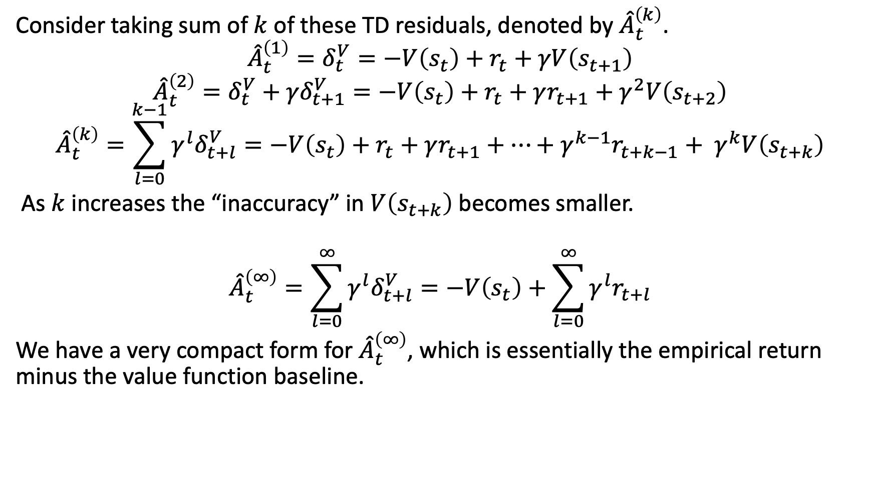
Finding ${\hat{A}}_{t}$
Consider taking sum of $k$ of these TD residuals, denoted by ${\hat{A}}_{t}^{\left(k\right)}$.
$${\hat{A}}_{t}^{\left(1\right)}=δ_{t}^{V}=−V\left(s_{t}\right)+r_{t}+γV\left(s_{t+1}\right)$$
$${\hat{A}}_{t}^{\left(2\right)}=δ_{t}^{V}+{γδ}_{t+1}^{V}=−V\left(s_{t}\right)+r_{t}+γr_{t+1}+γ^{2}V\left(s_{t+2}\right)$$
$${\hat{A}}_{t}^{\left(k\right)}=\sum_{l=0}^{k−1}{{γ^{l}δ}_{t+l}^{V}}=−V\left(s_{t}\right)+r_{t}+γr_{t+1}+…+γ^{k−1}r_{t+k−1}+ γ^{k}V\left(s_{t+k}\right)$$
As $k$ increases the “inaccuracy” in $V\left(s_{t+k}\right)$ becomes smaller.
$${\hat{A}}_{t}^{\left(∞\right)}=\sum_{l=0}^{∞}{{γ^{l}δ}_{t+l}^{V}}=−V\left(s_{t}\right)+\sum_{l=0}^{∞}{γ^{l}r_{t+l}}$$
We have a very compact form for ${\hat{A}}_{t}^{\left(∞\right)}$, which is essentially the empirical return minus the value function baseline.

Slide 9
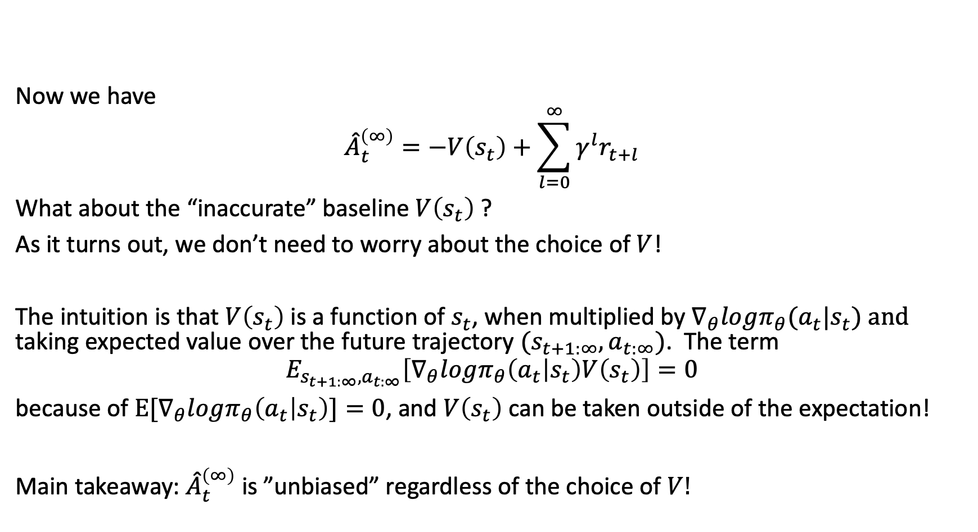
Finding ${\hat{A}}_{t}$
Now we have
$${\hat{A}}_{t}^{\left(∞\right)}=−V\left(s_{t}\right)+\sum_{l=0}^{∞}{γ^{l}r_{t+l}}$$
What about the “inaccurate” baseline $V\left(s_{t}\right)$ ?
As it turns out, we don’t need to worry about the choice of $V$!
The intuition is that $V\left(s_{t}\right)$ is a function of $s_{t}$, when multiplied by $∇_{θ}logπ_{θ}(a_{t}|s_{t}) and$ taking expected value over the future trajectory $(s_{t+1:∞},a_{t:∞})$. The term
$$E_{s_{t+1:∞},a_{t:∞}}\left[∇_{θ}logπ_{θ}\left(a_{t} | s_{t}\right)V\left(s_{t}\right)\right]=0$$
because of $E[∇_{θ}logπ_{θ}\left(a_{t} | s_{t}\right)]=0$, and $V\left(s_{t}\right)$ can be taken outside of the expectation!
Main takeaway: ${\hat{A}}_{t}^{\left(∞\right)}$ is ”unbiased” regardless of the choice of $V!$

Slide 10
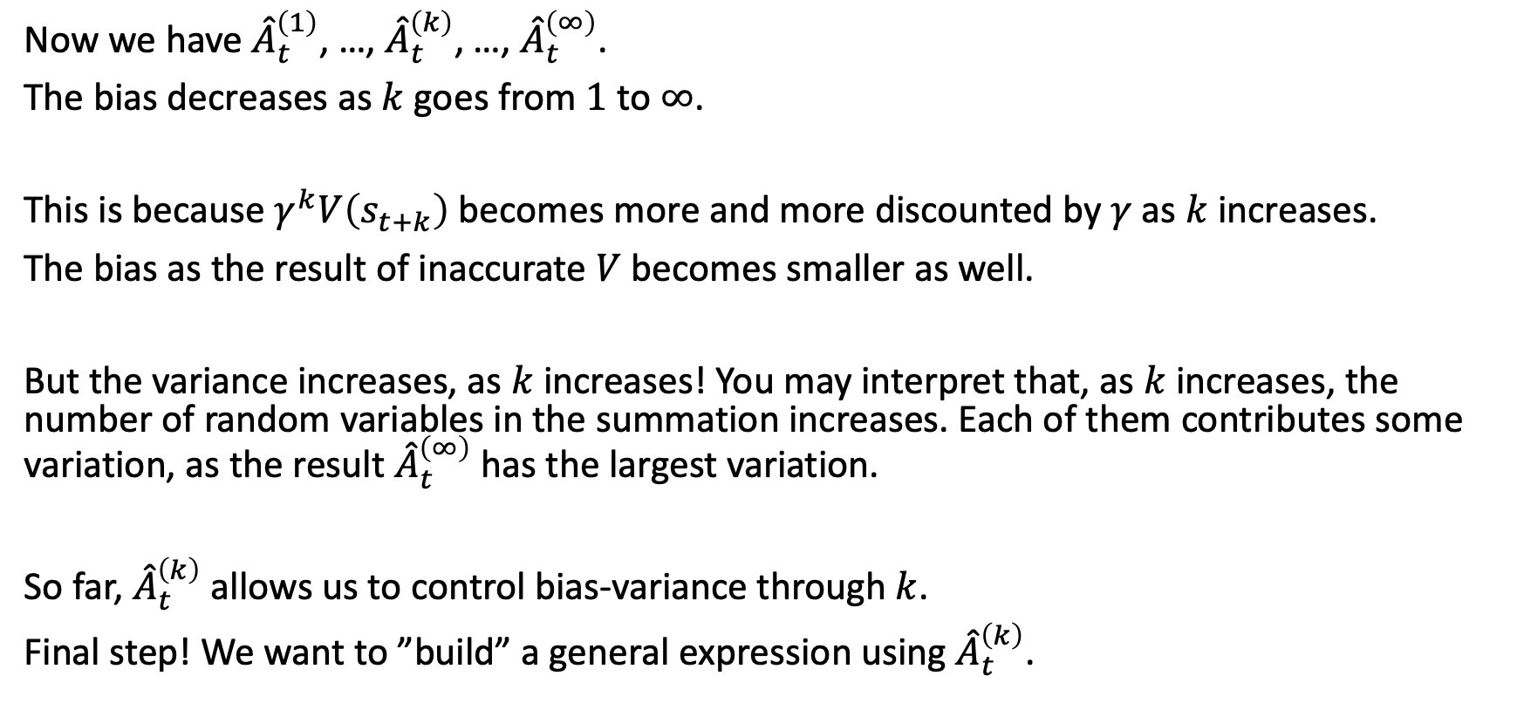

Final remark on ${\hat{A}}_{t}^{\left(k\right)}$
Now we have ${\hat{A}}_{t}^{\left(1\right)}$, …, ${\hat{A}}_{t}^{\left(k\right)}$, …, ${\hat{A}}_{t}^{\left(∞\right)}$.
The bias decreases as $k$ goes from $1$ to $∞$.
This is because $γ^{k}V\left(s_{t+k}\right)$ becomes more and more discounted by $γ$ as $k$ increases.
The bias as the result of inaccurate $V$ becomes smaller as well.
But the variance increases, as $k$ increases! You may interpret that, as $k$ increases, the number of random variables in the summation increases. Each of them contributes some variation, as the result ${\hat{A}}_{t}^{\left(∞\right)}$ has the largest variation.
So far, ${\hat{A}}_{t}^{\left(k\right)}$ allows us to control bias-variance through $k$.
Final step! We want to ”build” a general expression using ${\hat{A}}_{t}^{\left(k\right)}$.

Slide 11
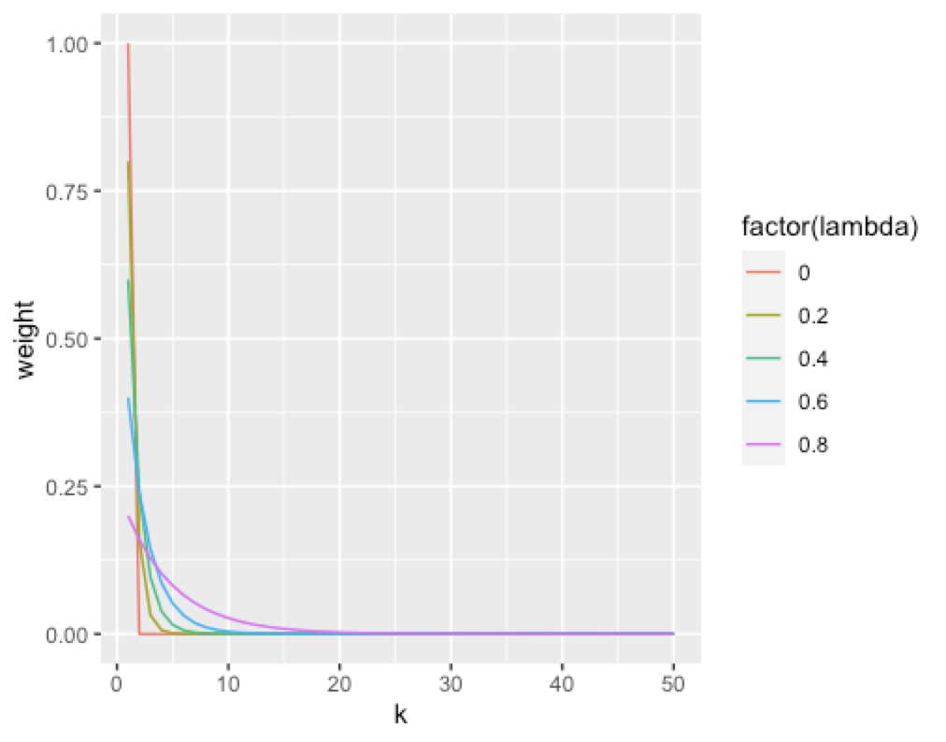
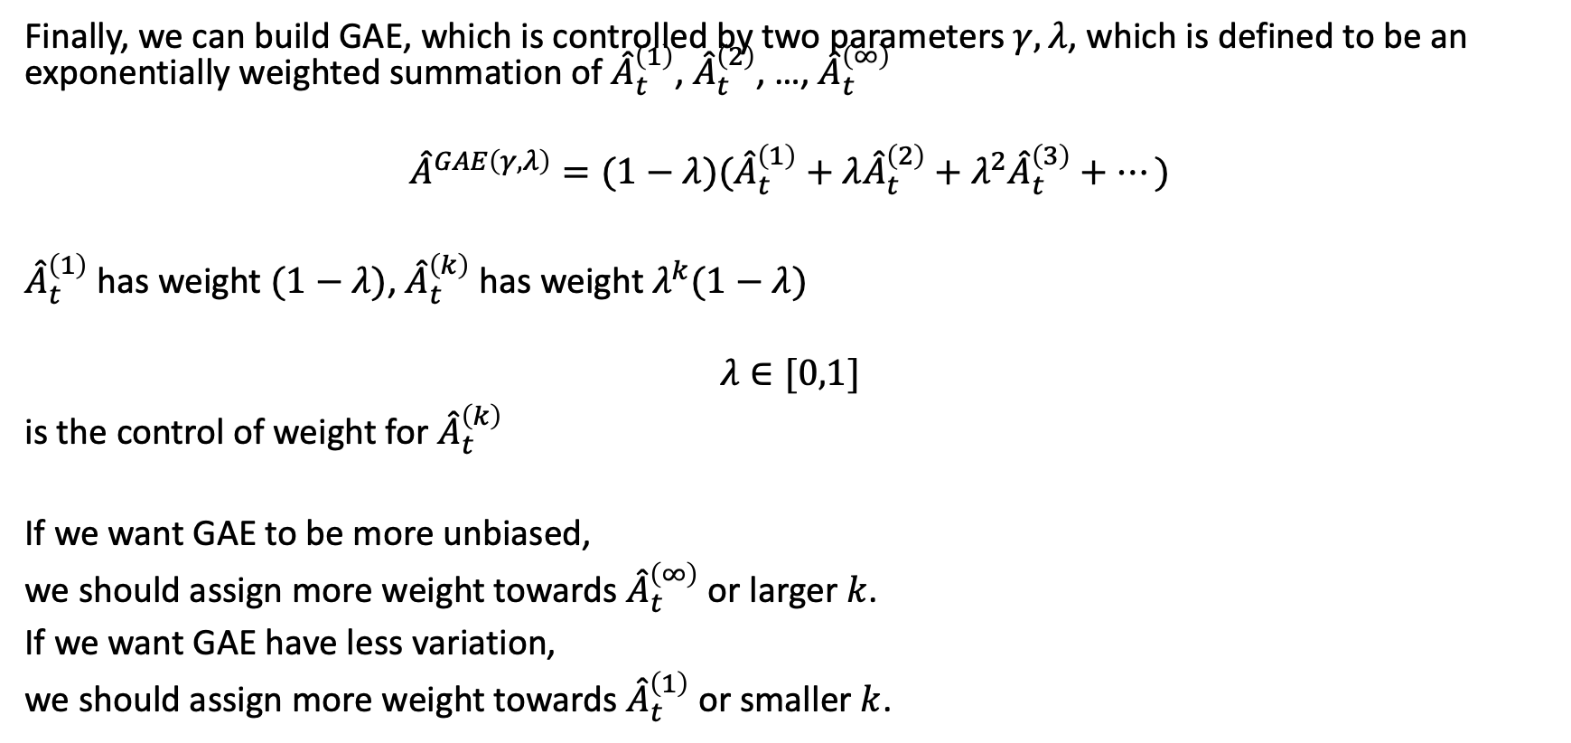
General Advantage Estimation (GAE)
Finally, we can build GAE, which is controlled by two parameters $γ, λ$, which is defined to be an exponentially weighted summation of ${\hat{A}}_{t}^{\left(1\right)}$, ${\hat{A}}_{t}^{\left(2\right)}$, …, ${\hat{A}}_{t}^{\left(∞\right)}$
$${\hat{A}}^{GAE\left(γ,λ\right)}=(1−λ)({\hat{A}}_{t}^{\left(1\right)}+λ{\hat{A}}_{t}^{\left(2\right)}+λ^{2}{\hat{A}}_{t}^{\left(3\right)}+…)$$
${\hat{A}}_{t}^{\left(1\right)}$ has weight $(1−λ)$, ${\hat{A}}_{t}^{\left(k\right)}$ has weight $λ^{k}(1−λ)$
$$λ∈[0,1]$$
is the control of weight for ${\hat{A}}_{t}^{\left(k\right)}$
If we want GAE to be more unbiased,
we should assign more weight towards ${\hat{A}}_{t}^{\left(∞\right)}$ or larger $k$.
If we want GAE have less variation,
we should assign more weight towards ${\hat{A}}_{t}^{\left(1\right)}$ or smaller $k$.

Slide 12
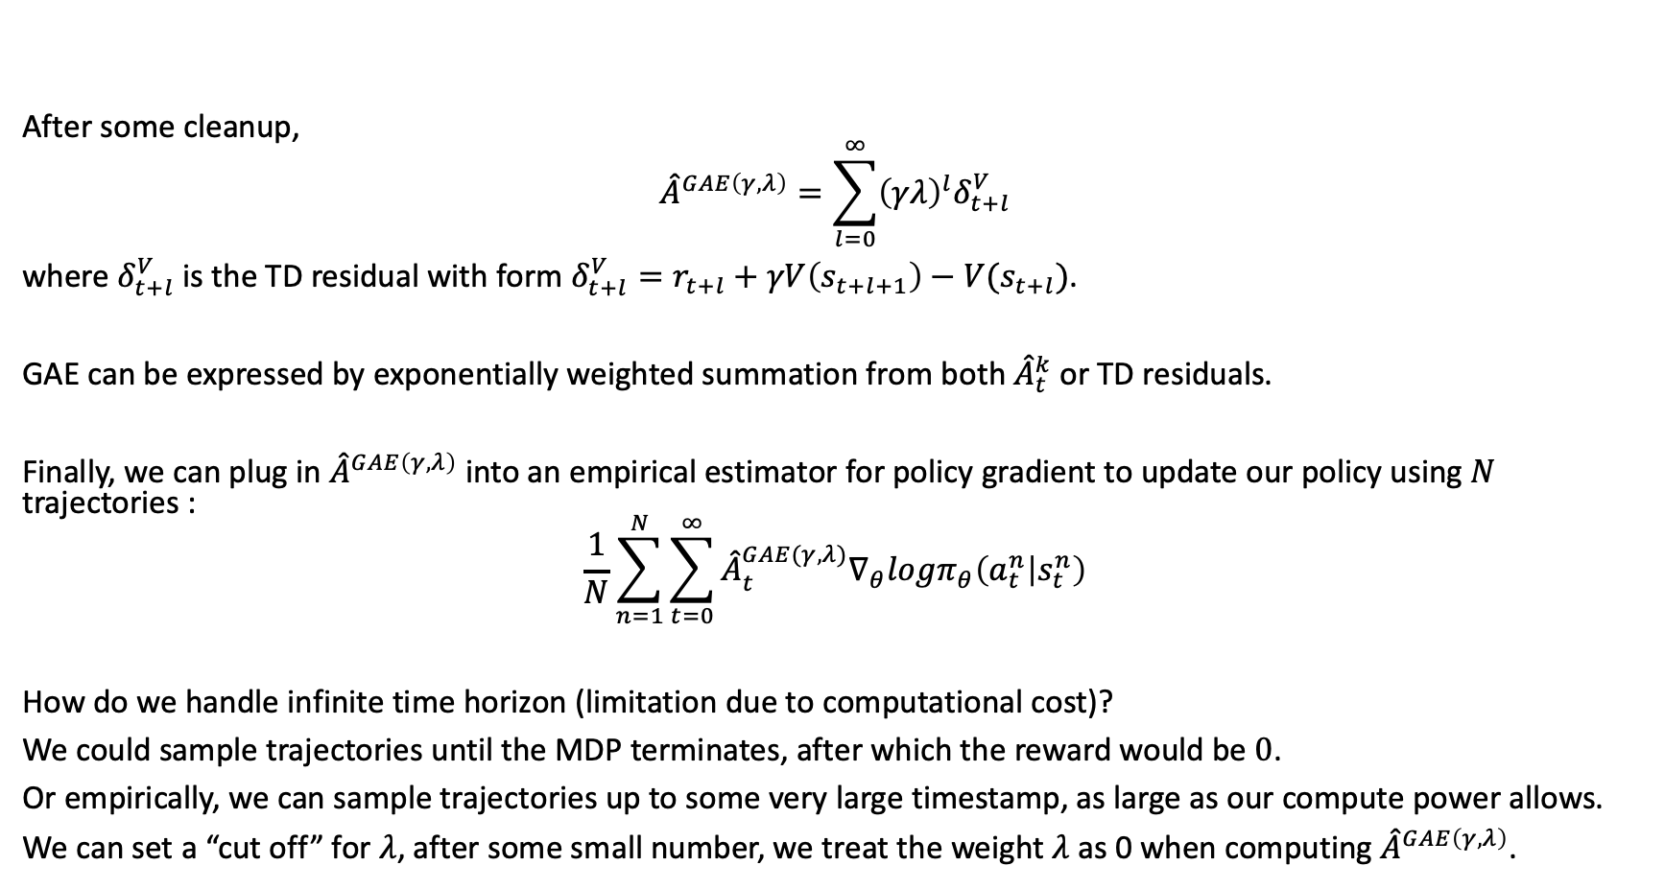
General Advantage Estimation (GAE)
After some cleanup,
$${\hat{A}}^{GAE\left(γ,λ\right)}=\sum_{l=0}^{∞}{{\left(γλ\right)}^{l}δ_{t+l}^{V}}$$
where $δ_{t+l}^{V}$ is the TD residual with form $δ_{t+l}^{V}=r_{t+l}+γV\left(s_{t+l+1}\right)−V(s_{t+l})$.
GAE can be expressed by exponentially weighted summation from both ${\hat{A}}_{t}^{k}$ or TD residuals.
Finally, we can plug in ${\hat{A}}^{GAE\left(γ,λ\right)}$ into an empirical estimator for policy gradient to update our policy using $N$ trajectories :
$$\frac{1}{N}\sum_{n=1}^{N}{\sum_{t=0}^{∞}{{\hat{A}}_{t}^{GAE(γ,λ)}∇_{θ}logπ_{θ}\left(a_{t}^{n} | s_{t}^{n}\right)}}$$
How do we handle infinite time horizon (limitation due to computational cost)?
We could sample trajectories until the MDP terminates, after which the reward would be $0$.
Or empirically, we can sample trajectories up to some very large timestamp, as large as our compute power allows.
We can set a “cut off” for $λ$, after some small number, we treat the weight $λ$ as 0 when computing ${\hat{A}}^{GAE\left(γ,λ\right)}$.

Slide 13
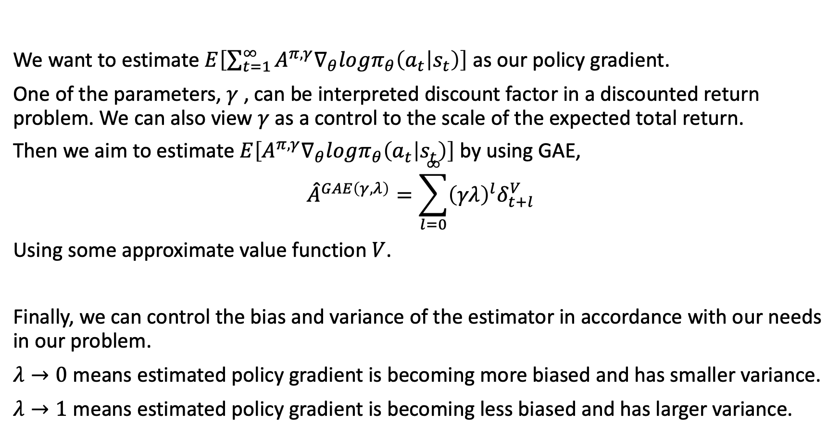
Summary
We want to estimate $E\left[\sum_{t=1}^{∞}{A^{π,γ}∇_{θ}logπ_{θ}\left(a_{t} | s_{t}\right)}\right]$ as our policy gradient.
One of the parameters, $γ$ , can be interpreted discount factor in a discounted return problem. We can also view $γ$ as a control to the scale of the expected total return.
Then we aim to estimate $E\left[A^{π,γ}∇_{θ}logπ_{θ}\left(a_{t} | s_{t}\right)\right]$ by using GAE,
$${\hat{A}}^{GAE\left(γ,λ\right)}=\sum_{l=0}^{∞}{{\left(γλ\right)}^{l}δ_{t+l}^{V}}$$
Using some approximate value function $V$.
Finally, we can control the bias and variance of the estimator in accordance with our needs in our problem.
$λ→0$ means estimated policy gradient is becoming more biased and has smaller variance.
$λ→1$ means estimated policy gradient is becoming less biased and has larger variance.

Slide 14
Schulman, John & Moritz, Philipp & Levine, Sergey & Jordan, Michael & Abbeel, Pieter. (2015).
High-Dimensional Continuous Control Using Generalized Advantage Estimation.

